Slide 1
ATCO Frontec Virtual Career Fair

Slide 2
ATCO Frontec
ATCO Frontec is a division of ATCO
We offer a diverse range of services, including camp operations, facilities maintenance and disaster and emergency management.

Slide 3
Types of Opportunities
Catering and kitchen operation positions
Housekeeping and janitorial positions
Repair and maintenance positions
Administrative positions

Slide 4
Current Opportunities
Two Rivers, Site C (Fort St. John, BC)
TransMountain Valemount Lodge (Valemount, BC)
TransMountain Clearwater Lodge (Clearwater, BC)
Husky Sunrise Lodge (Fort McMurray, AB)
Elk Valley Lodge (Elkford, BC)
Silvertip Lodge (Watson Lake, BC)

Slide 5
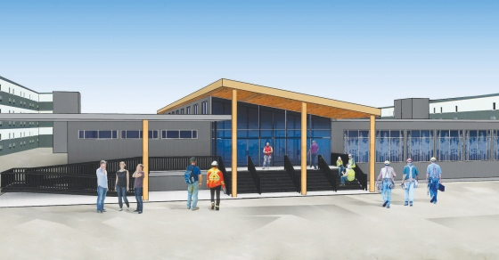

Two Rivers Lodge
This camp is a hotel-style workforce accommodation facility with 2,500 person occupancy supporting the construction of the Site C dam project.
Highlights:
Camp opened in 2016
Full time, permanent positions with the Teamsters Union
Over 200 employees are part of the ATCO Team at this project
The work rotation at this project is 14 days on, 7 days off
Travel allowance is included based on the employee's distance from site.

Slide 6
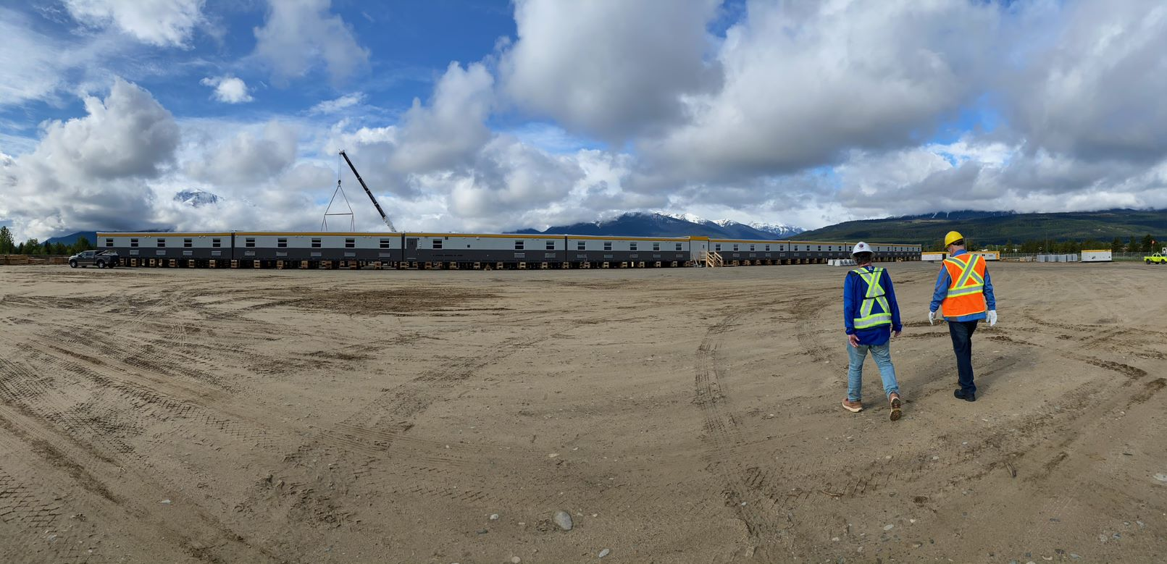
Transmountain Valemount Lodge
This camp is a hotel-style workforce accommodation facility with 600 person occupancy.
Highlights:
Camp opened July 2020
The facility will operate for 30 months
Full time positions
Local employees work on a 4 day on, 4 day off rotation
Non local employees work on a 20 day on, 10 day off rotation.

Slide 7

Transmountain Clearwater Lodge
This camp is a hotel-style workforce accommodation facility with 600 person occupancy.
Highlights:
Camp will open Oct 2020
The facility will operate for 30 months
Full time positions
Local employees work on a 4 day on, 4 day off rotation
Non local employees work on a 20 day on, 10 day off rotation.

Slide 8
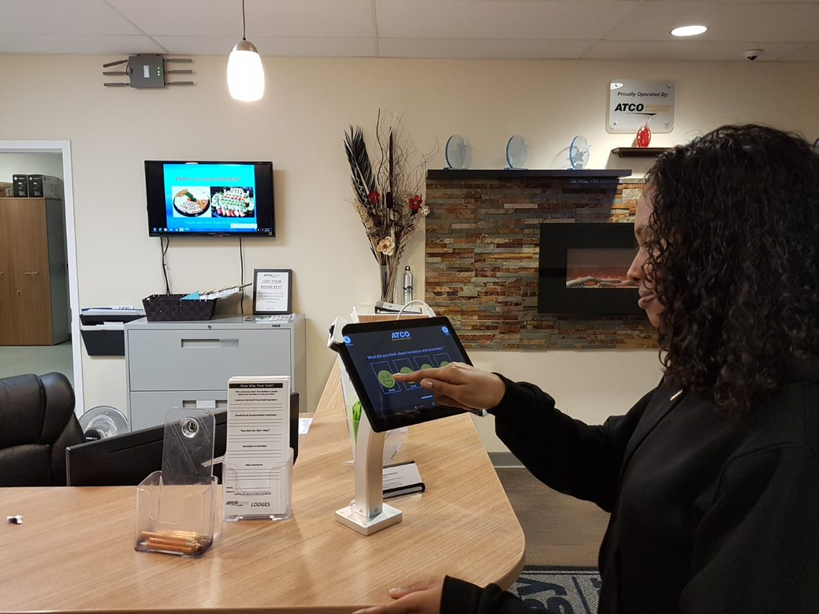
Husky Sunrise Lodge
This camp is a hotel-style workforce accommodation facility with 1,400 person occupancy supporting the Husky Sunrise oil and gas project site
Highlights:
Camp opened in 2015
Full time, permanent positions
The work rotation at this project is 21 days on, 7 days off
Flights are included from Calgary, AB and Edmonton, AB

Slide 9
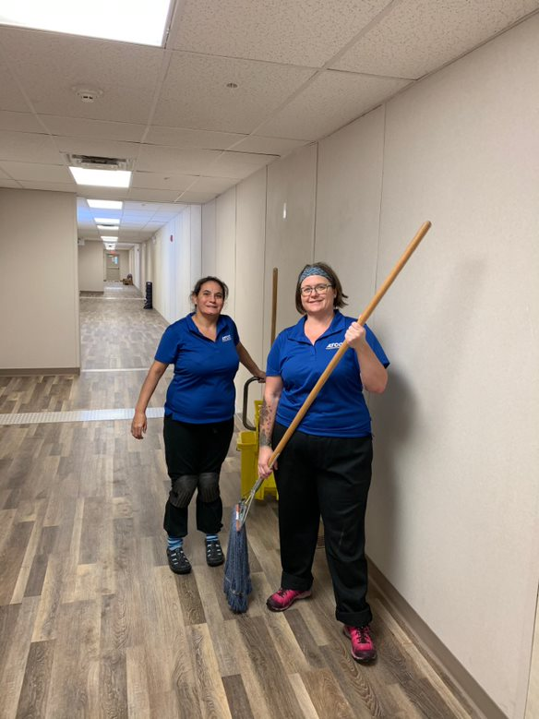
Elk Valley Lodge
This camp is a hotel-style workforce accommodation facility with 450 person occupancy supporting the mining industry in the Elk Valley region
Highlights:
Camp opened in 2019
Full time, permanent positions
Local employees work on a 4 day on, 4 day off rotation
Non local employees work on a 20 day on, 10 day off rotation.

Slide 10
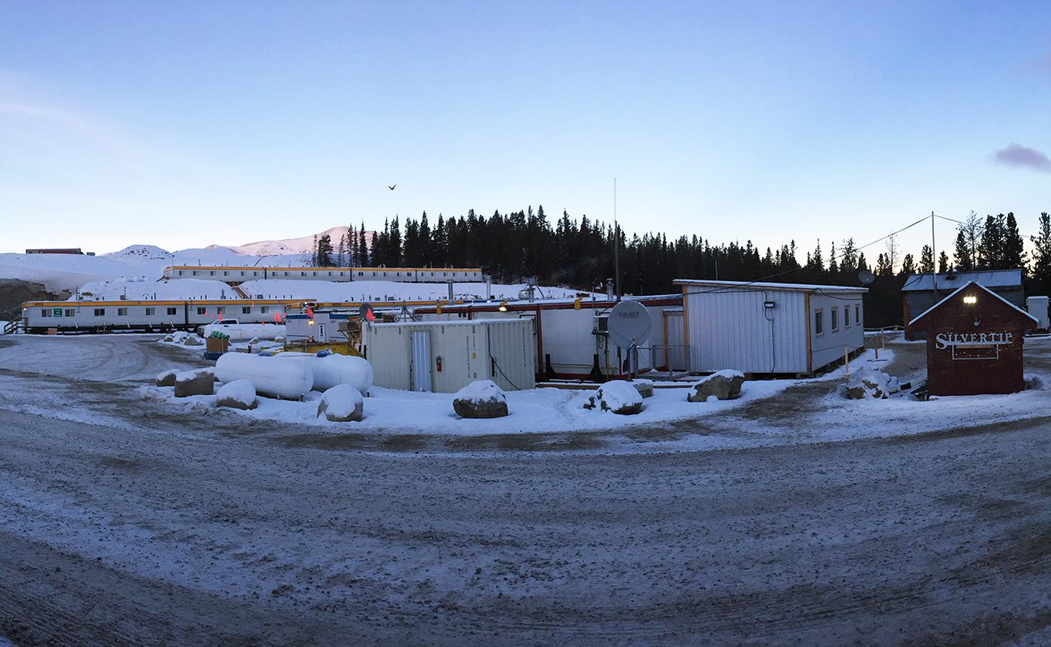
Silvertip Lodge
This camp is a hotel-style workforce accommodation facility with 250 person occupancy supporting the Couer Silvertip Mine.
Highlights:
Camp opened in 2018
Full time, permanent positions
All positions work on a 14 day on, 14 day off rotation with 12-hour shifts.
Flights are included from Kelowna, Nanaimo, Prince George, Whitehorse, and Vancouver.

Slide 11
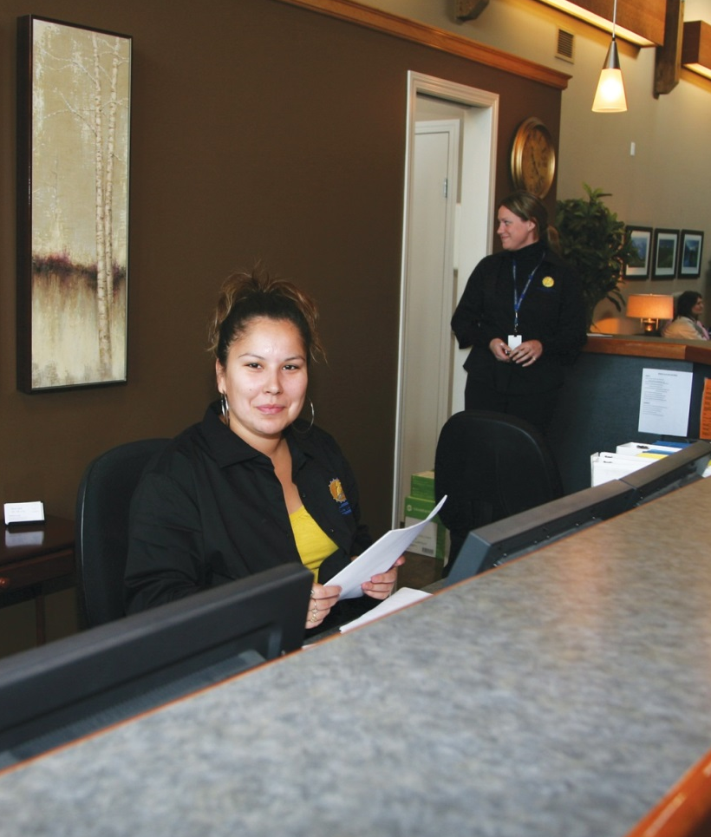
Available Positions
1st Cook
2nd Cook
3rd Cook
Bakers Assistant
Salad Sandwich Maker
Dishwasher
Kitchen Help
Housekeeping
Janitorial
Front Desk
Maintenance/Trades

Slide 12
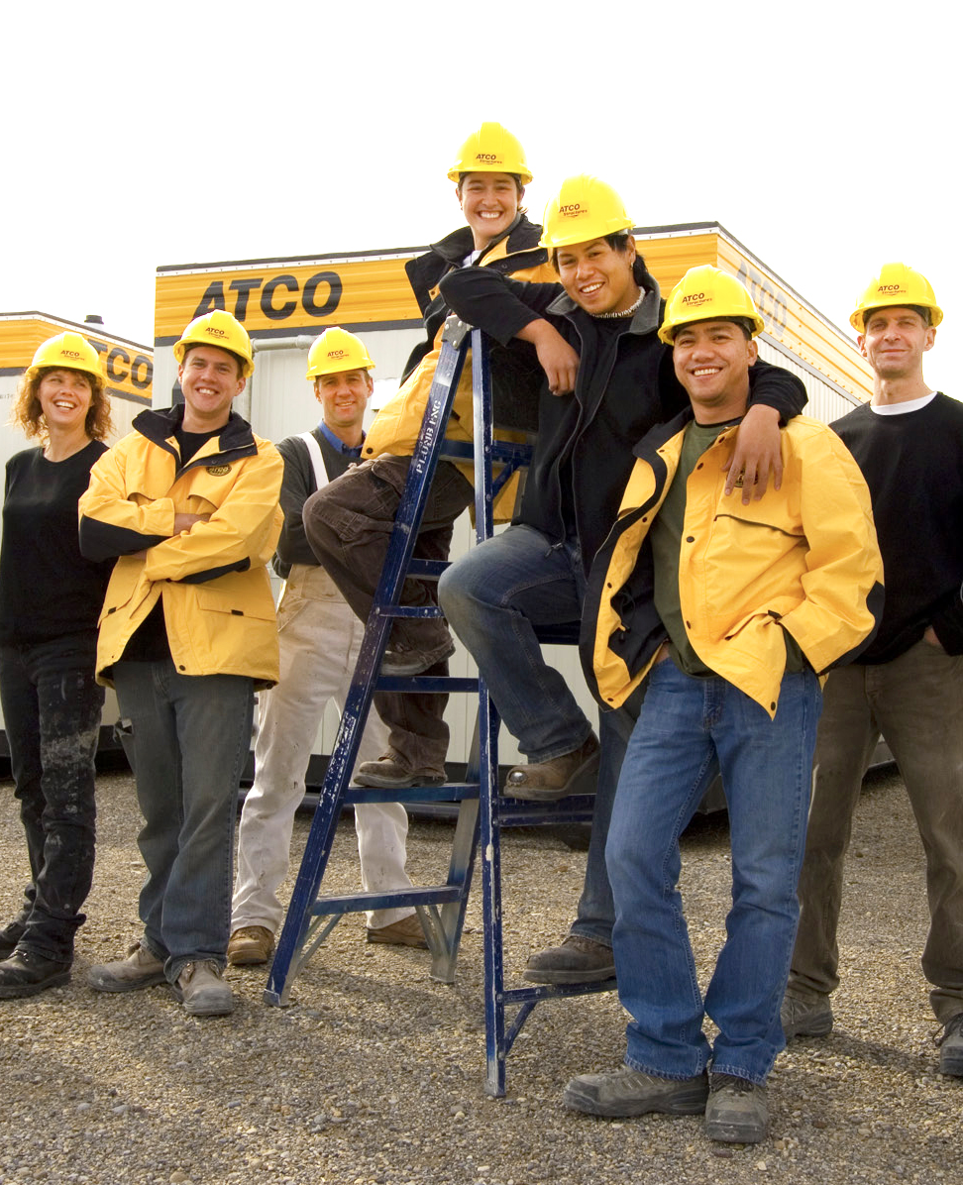
Employment Details
Pay is biweekly, via direct deposit
Employees are eligible for benefits after 90 days
Alcohol and drug testing is required for all employees
Fitness testing is required for all employees
Criminal record checks are also required for all employees

Slide 13


